Slide 1
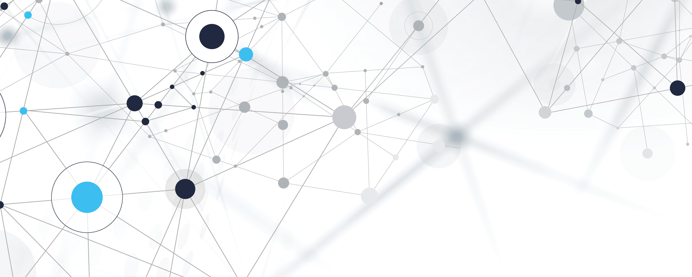
Flensburg Fjord food web
Niccolo Ducci Mat:7036789

Slide 2

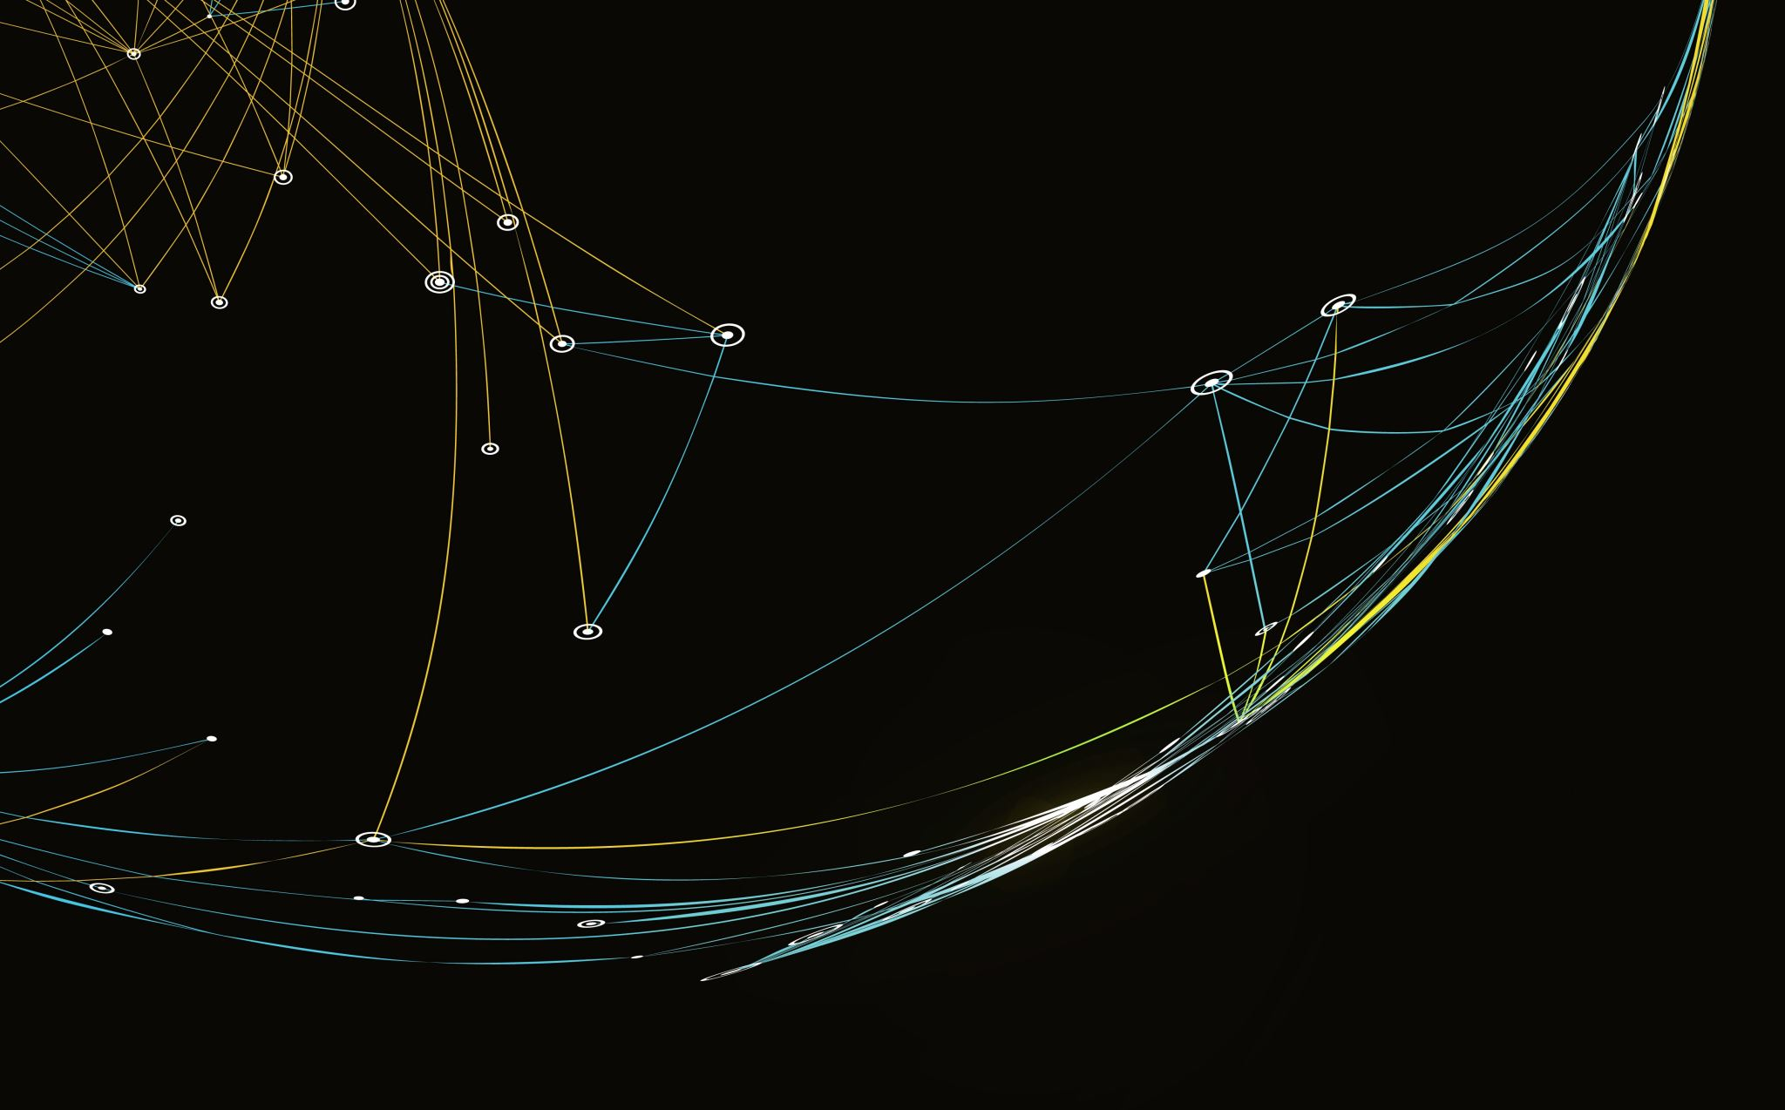
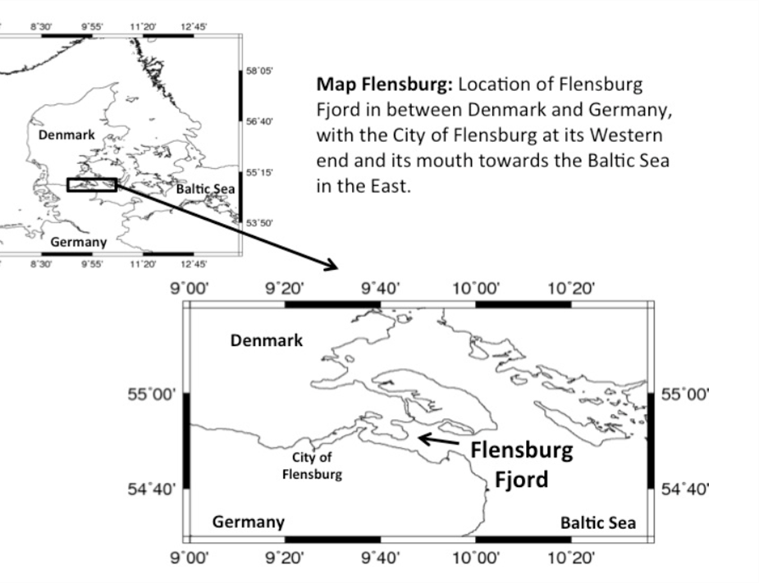
The Flensburg Fjord
The Flensburg Fjord is a 50 km inlet of the Baltic Sea. The Fjord forms part of the border between Denmark to the North and Germany to the South.

Slide 3
THE DATA
The data is divided in two dataset: one for the nodes of the network called “Flensburg_Data_Nodes.csv” and another one for the edges called “Flensburg_Data_Links”.
Flensburg_Data_Nodes
Flensburg_Data_Link
Nodes | Nodes Attributes
180 | 15
Edges | Edge Attributes
1577 | 8

Slide 4
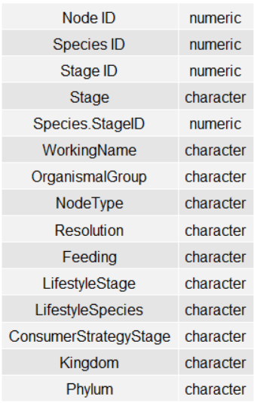
Nodes of the Network and their attributes
The Nodes of the Network represent living organism, characterized by specie and that evolutional stage inhabits the Flensburg Fjord.(There are parasitic animals that evolve through different stages).

Slide 5
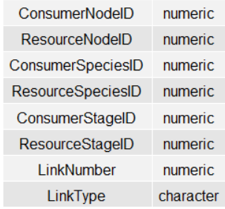
Edges of the Network and their attributes
The edges of the network represent trophic relationships among living organism. Edges are directed and classified by type of trophic relation. A trophic relationtionship is the feeding interaction between organisms that “ eat ” and organisms that “are eaten”

Slide 6
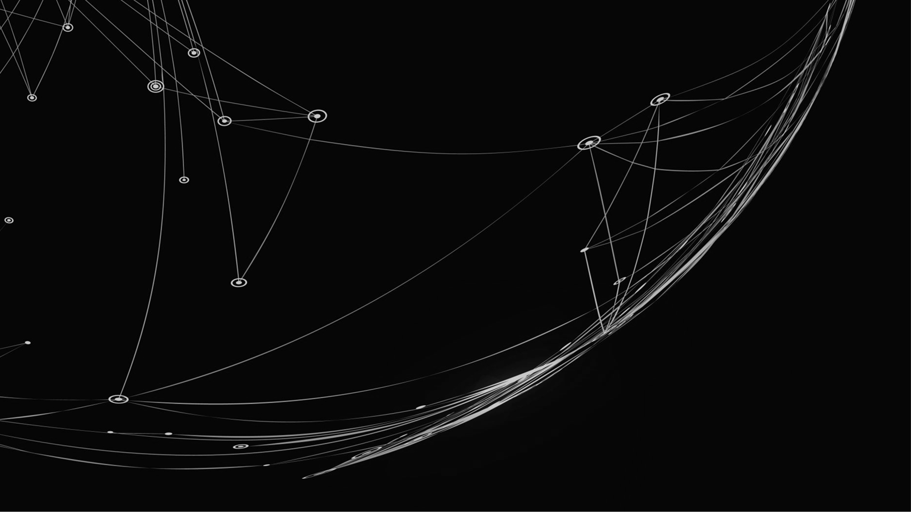
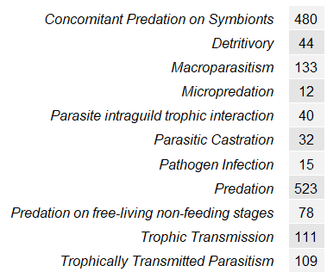
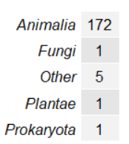
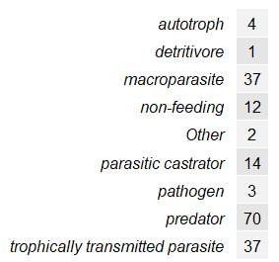
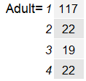
Summary of some Nodal and edge Attributes
Consumer Stage Strategy
Edge Attributes
Animal Kingdom
Stage ID

Slide 7
Subset of the Data
Flensburg Fjord Data
Nodes | Edges
180 | 1577
In order to make computation easier, all the organism who didn’t belong to the animal kingdom were discarded, leaving the data with 172 nodes and 1416 edge.
Also, two self-loop edges were discarded.
Only Animals Flensburg Fjord Data
Nodes | Edges
172 | 1416

Slide 8
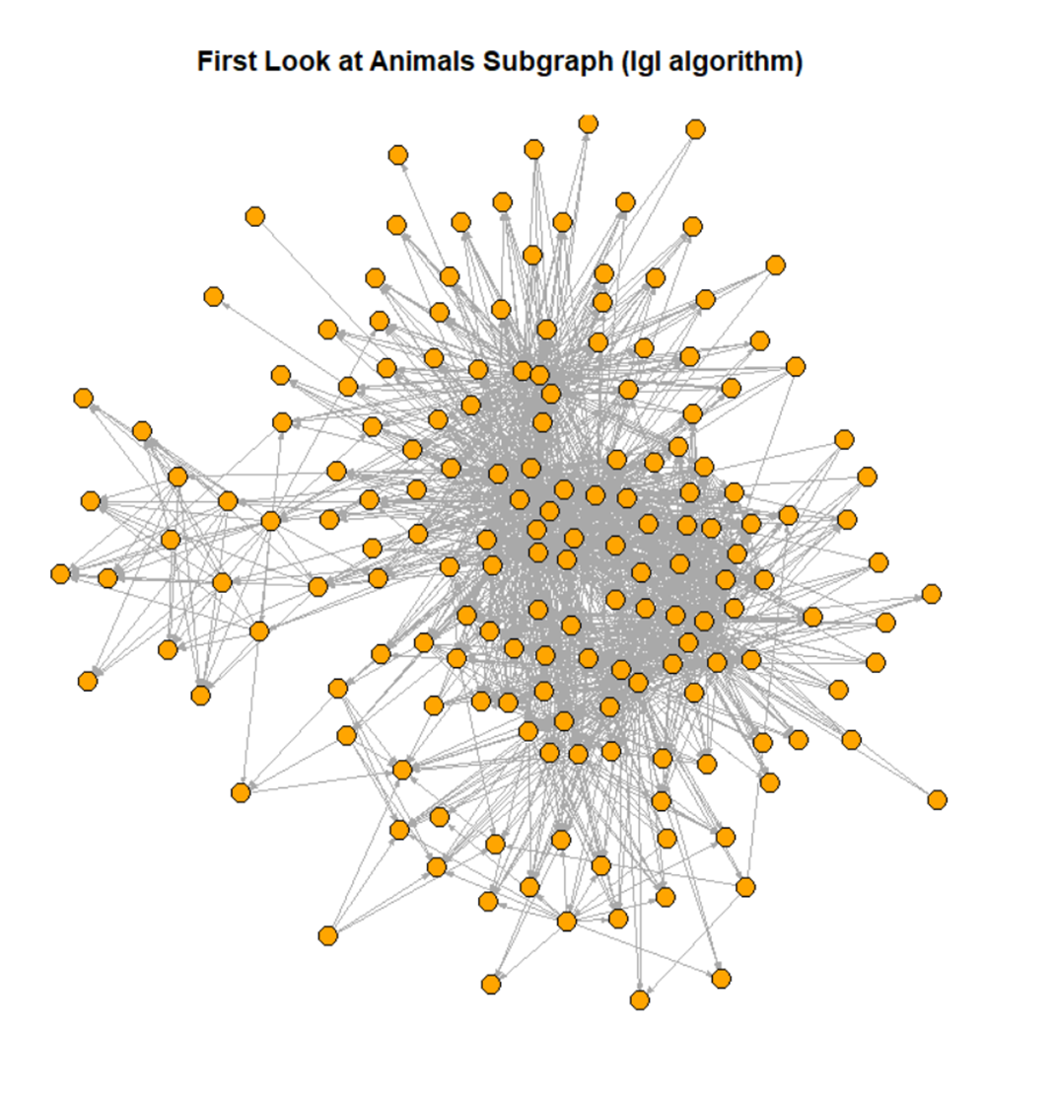
The Graph
Lgl algorithm used for a better representation
The graph is connected,there are no isolated nodes
Central in the representation nodes very connected
Overall the graph is too big in order to gain any relevant information just by looking at the graphical representation

Slide 9
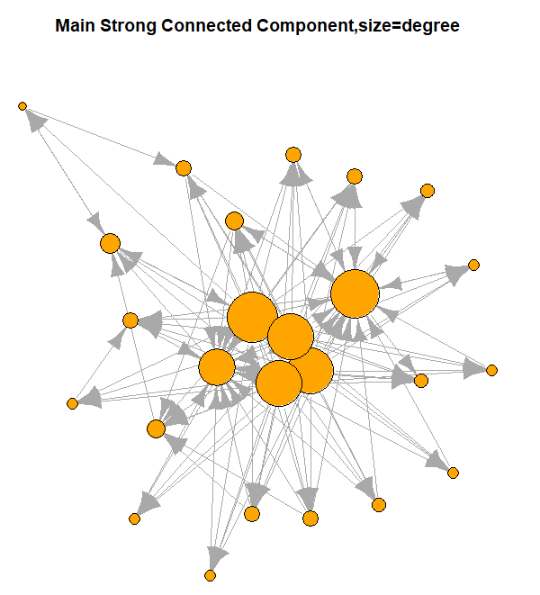
Strong Components
The graph is composed of 146 strong components, of which only two have more than one node, there is a strong component of 25 nodes.
This suggests low reciprocity and propension to cluster of the nodes.

Slide 10
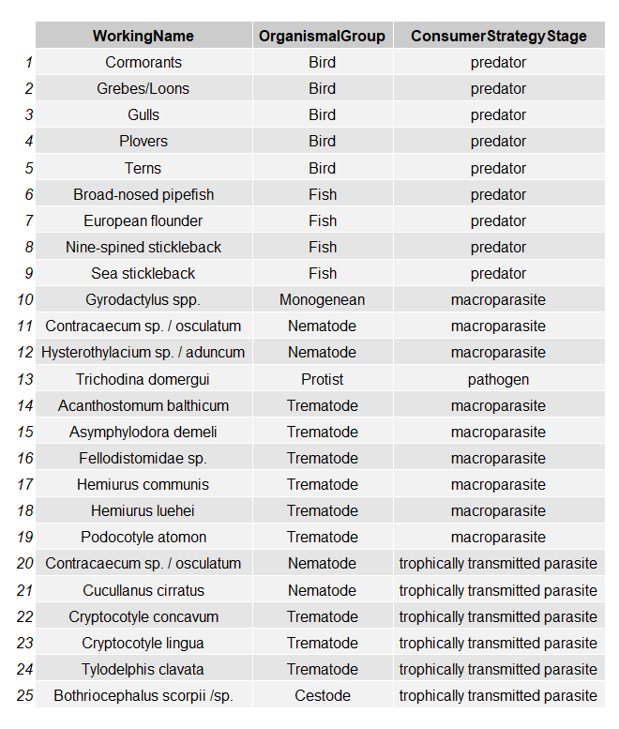
Nodes Involved in the Main Strong Component
As we can see this is a clique of 25 nodes that describe a trophic niche between various animals.

Slide 11
Network Statistics
NETWORK STATISTIC | VALUE
Density | 0.04814361
Reciprocity | 0.01129944
Transitivity | 0.1892748
OddsRatio Transitivity vs Density | 4.615852
The graph is sparse , there is low reciprocity.
Transitivity in the nertwork is higher than density,as it can also be seen from the odds ratio, this means that the chance of observing a relation between nodes sharing a common relation is more than 4 times higher than that of observing a relation between two randomly selected nodes

Slide 12
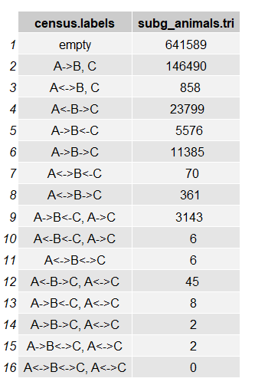
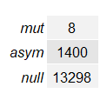
Dyads and Triads Census
Tryad Census
Dyad Census
The Triad and Dyad census highlight how the node is sparse and there are almost no clusters.

Slide 13
ASSORTATIVE MIXING
Node Attribute | Assortativity
Phylum | -0.1604368
Predator | -0.3491134
Stage | -0.0490566
OrganismalGroup | -0.1008899
The is a clear disassortative mixing tendency; as it was expected since animals rarely predate other animals like them in terms of size or organismal group.

Slide 14
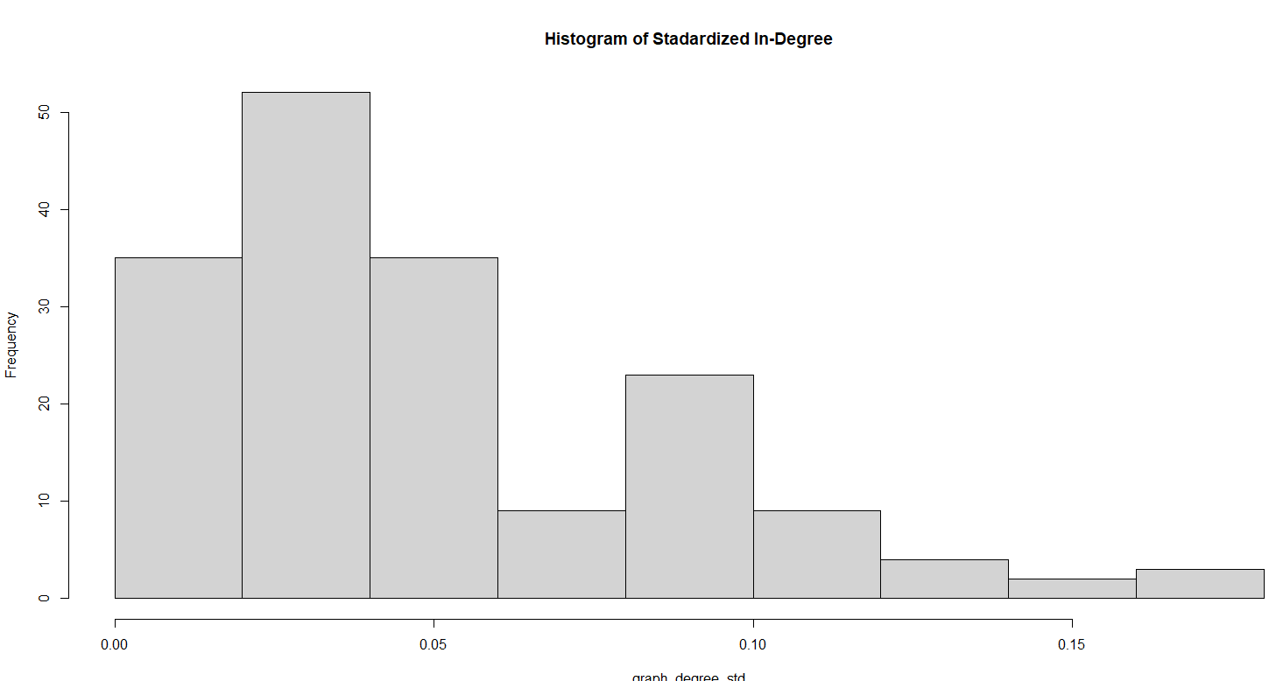
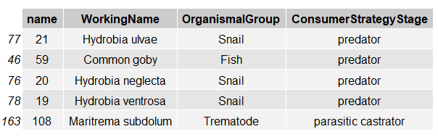
Nodal Statistics: In Degree Centrality

Slide 15
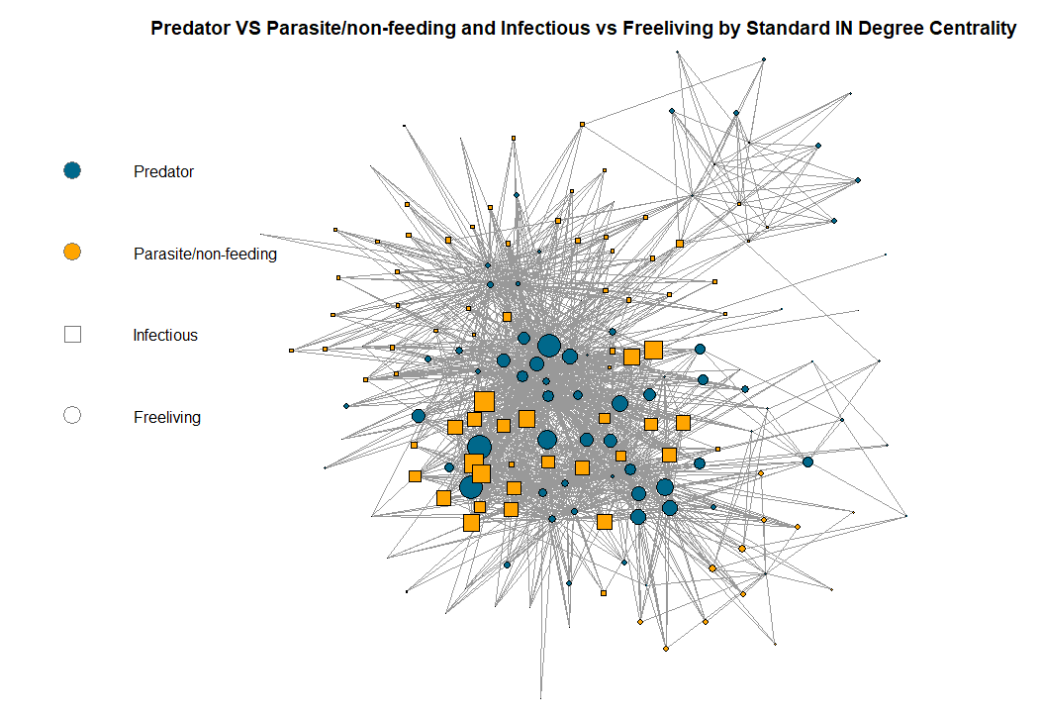
Nodal Statistics: In Degree Centrality

Slide 16
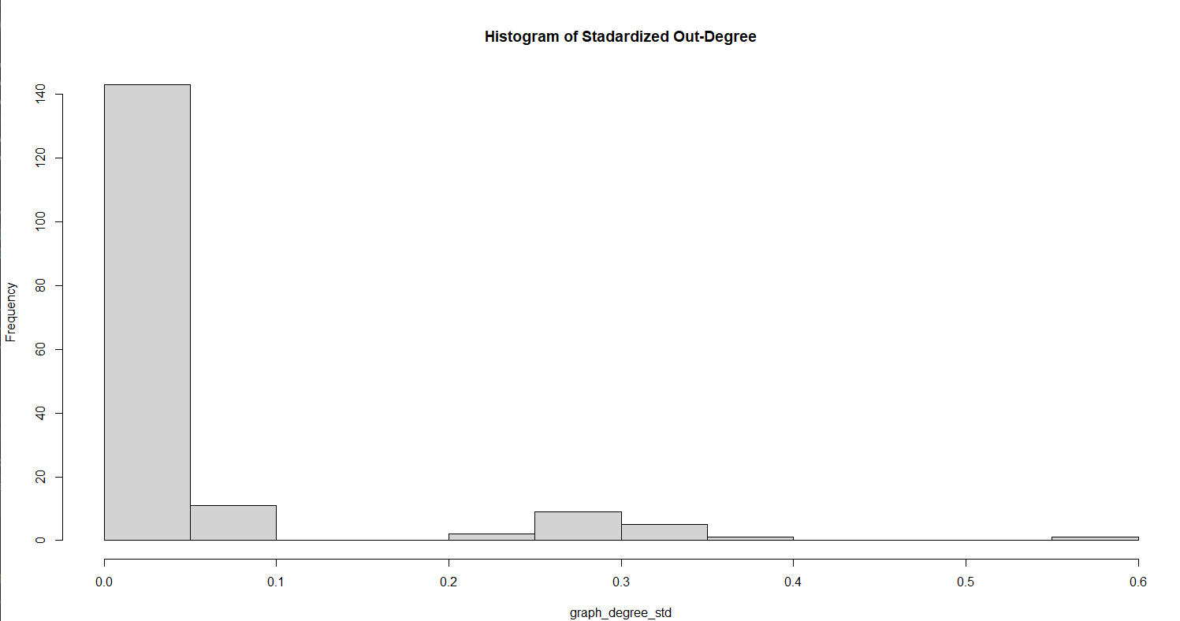
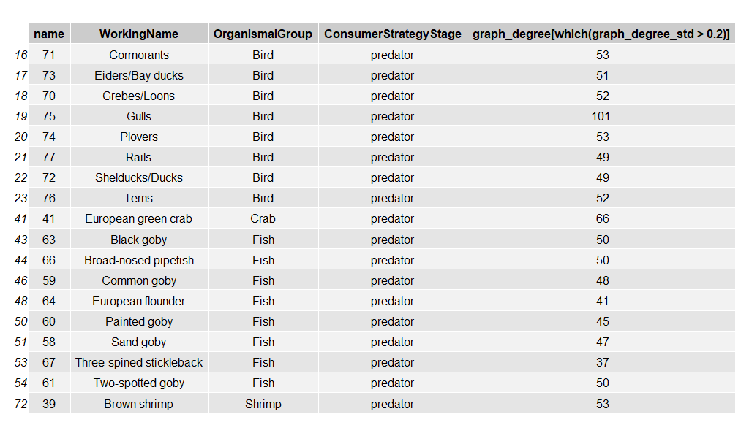
Nodal Statistics: Out Degree Centrality

Slide 17
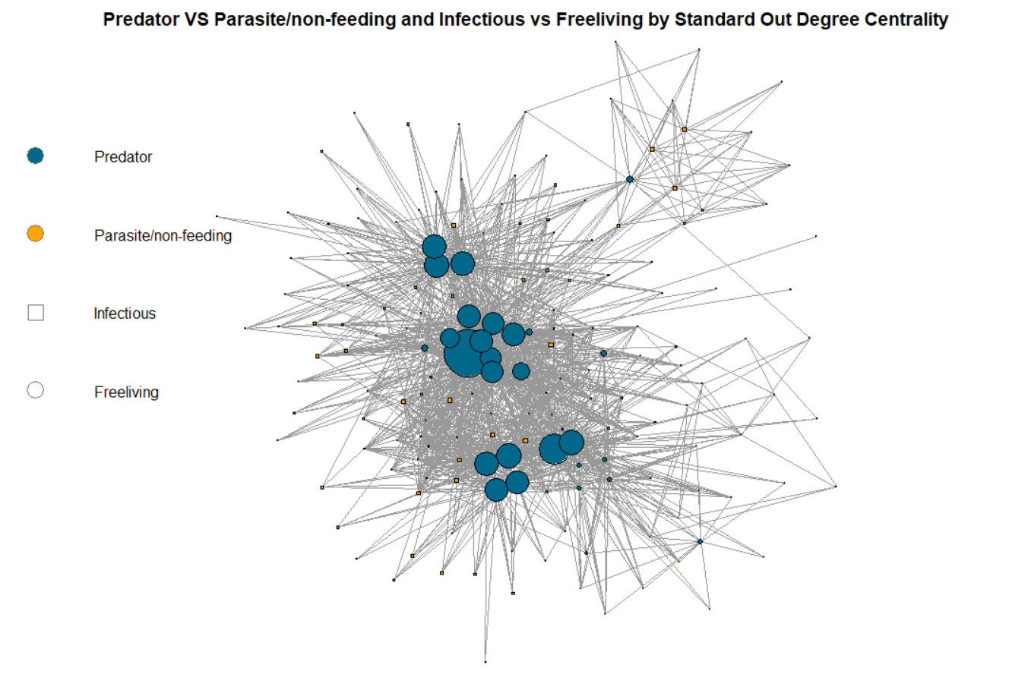
Nodal Statistics: Out Degree Centrality
gulls

Slide 18
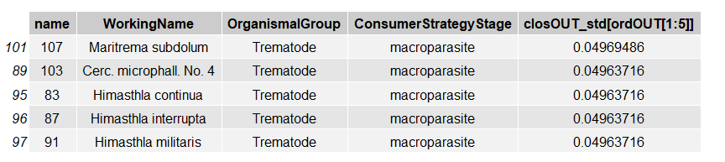
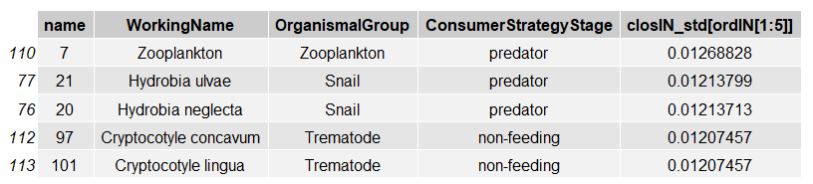
Nodal Statistics: Closeness Centrality
Top 5 Nodes by OUT Closeness centrality
Top 5 Nodes by IN Closeness centrality

Slide 19
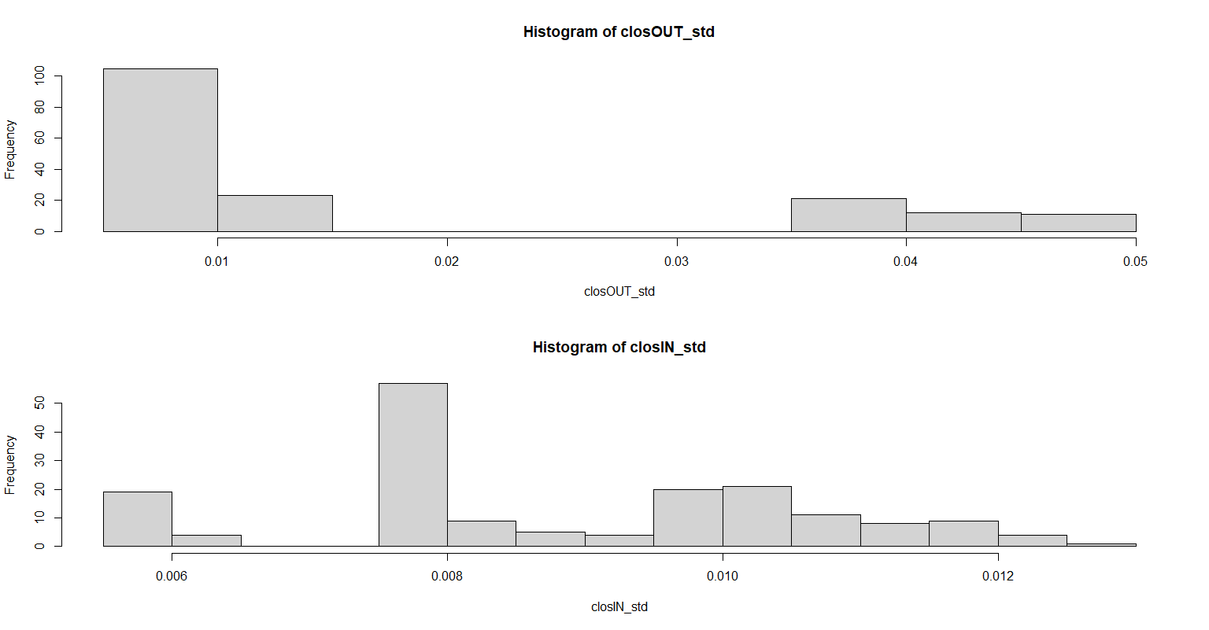
Nodal Statistics: Closeness Centrality

Slide 20
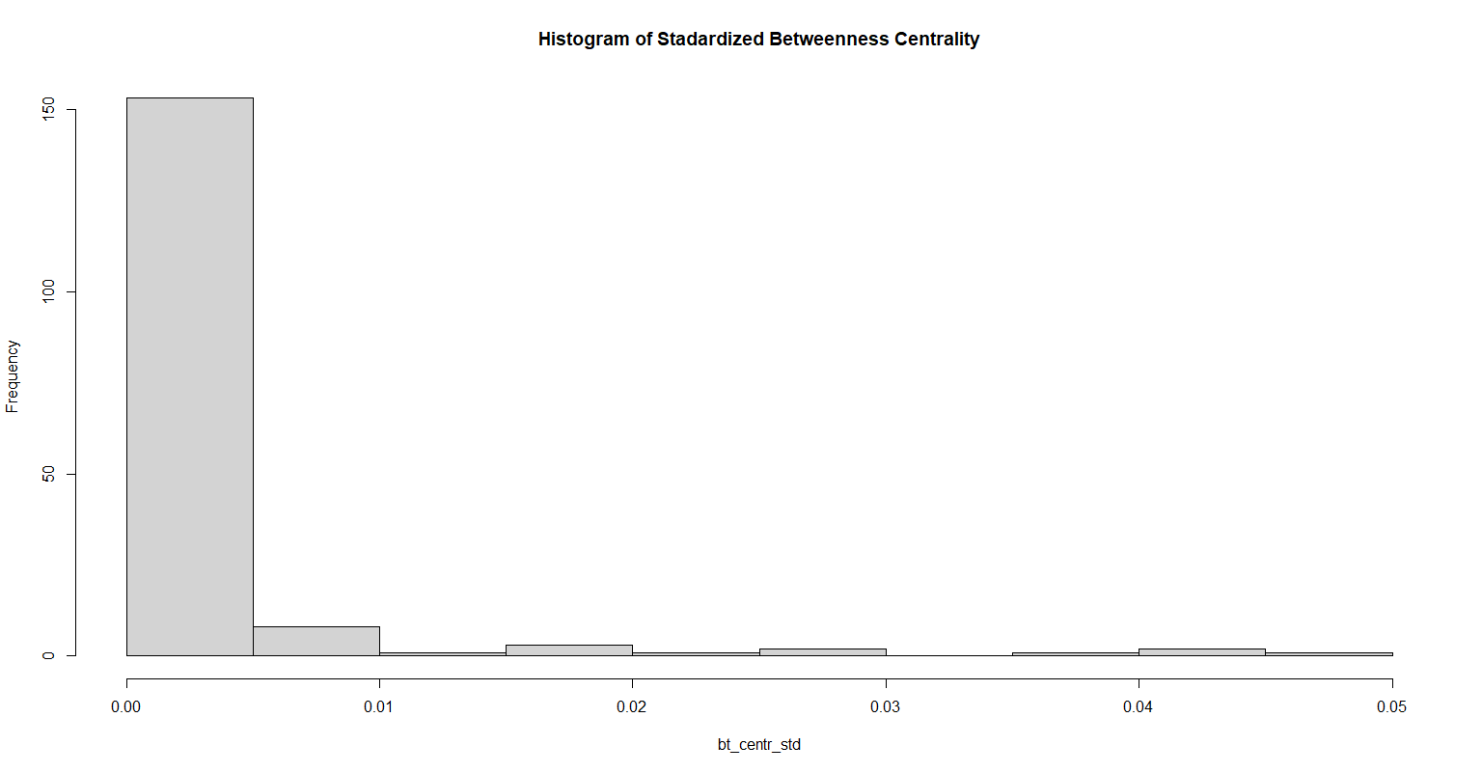
Nodal Statistics: Betweenness Centrality

Slide 21
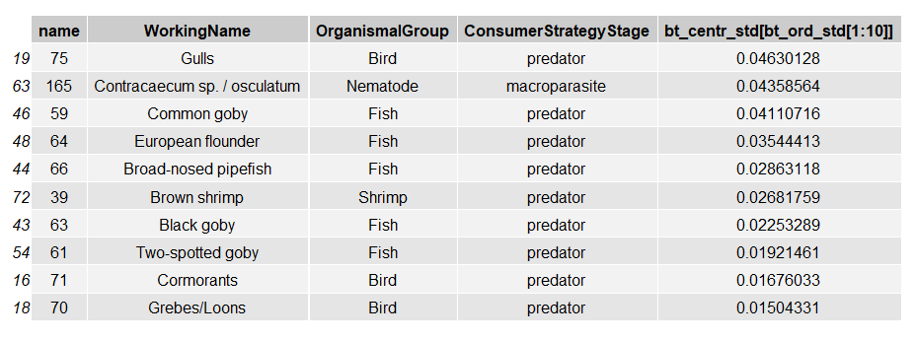
Nodal Statistics: Betweenness Centrality

Slide 22
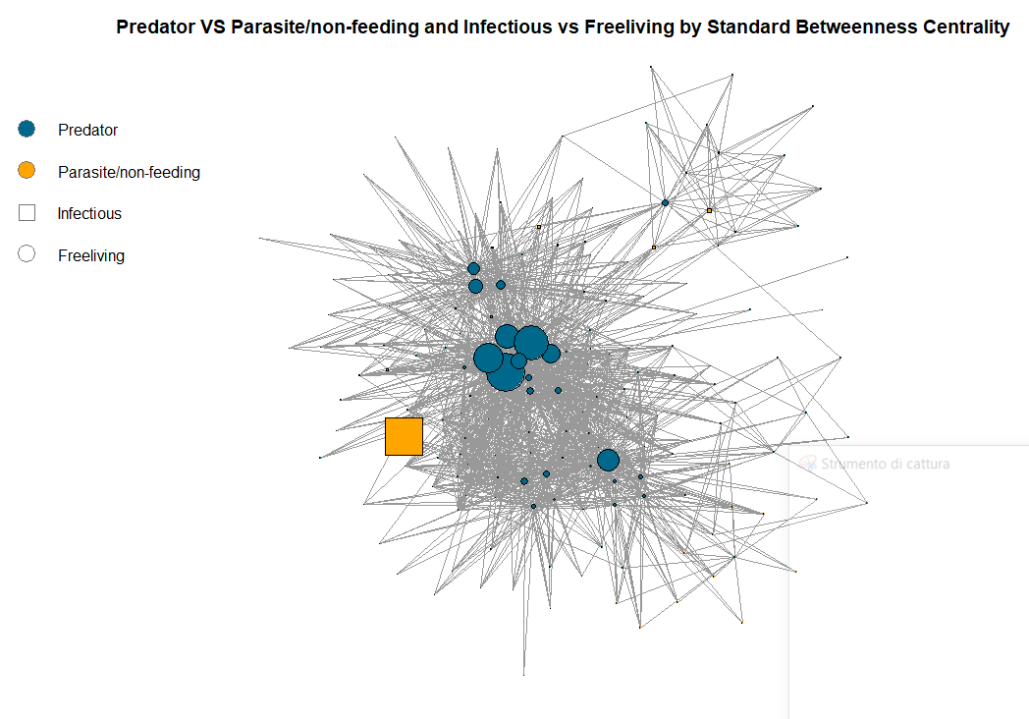
Nodal Statistics: Betweenness Centrality

Slide 23
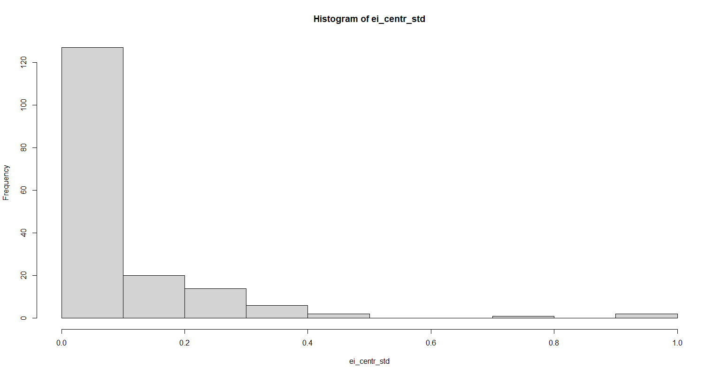
Nodal Statistics: Eigenvector Centrality

Slide 24

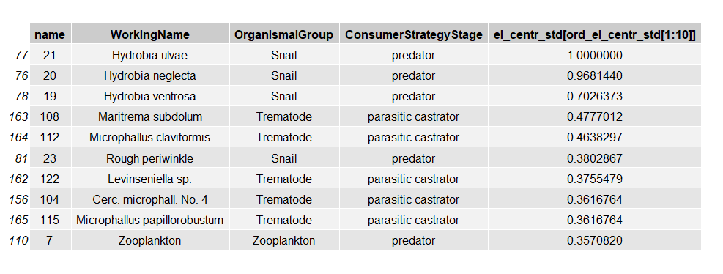

Slide 25
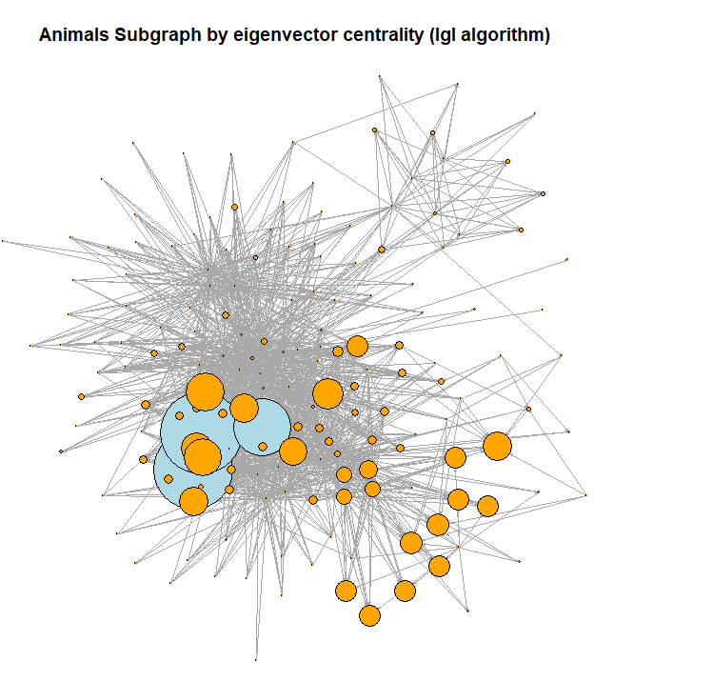

Slide 26
Network Centralization
Centralization Index | Value
Eigenvector Centralization | 0.9220754
In-Degree Centralization | 0.1221572
Out-Degree Centralization | 0.5456722
Out-Closeness Centralization | 0.03406177
In-Closeness Centralization | 0.003893666
All-Closeness Centralization | 0.5630227
Betweenness Centralization | 0.04402083

Slide 27
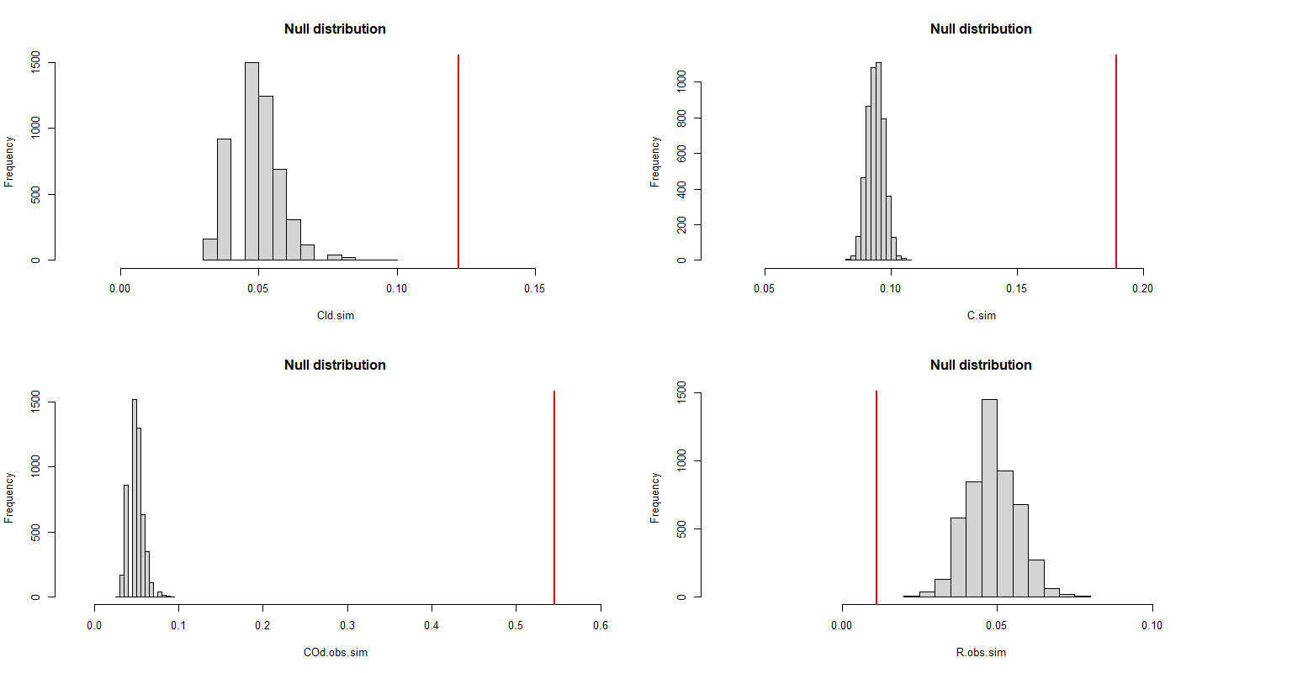
Simple Random Graph Test-Formal Approach

Slide 28
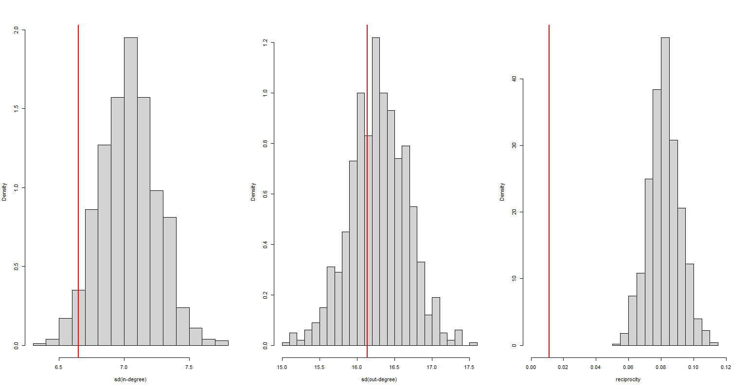
Non-Homogeneous Exponential Random Graph Test-Naive Approach
In-Degree Variation P-value | 0.036
In-Degree Variation P-value | 0.341

Slide 29
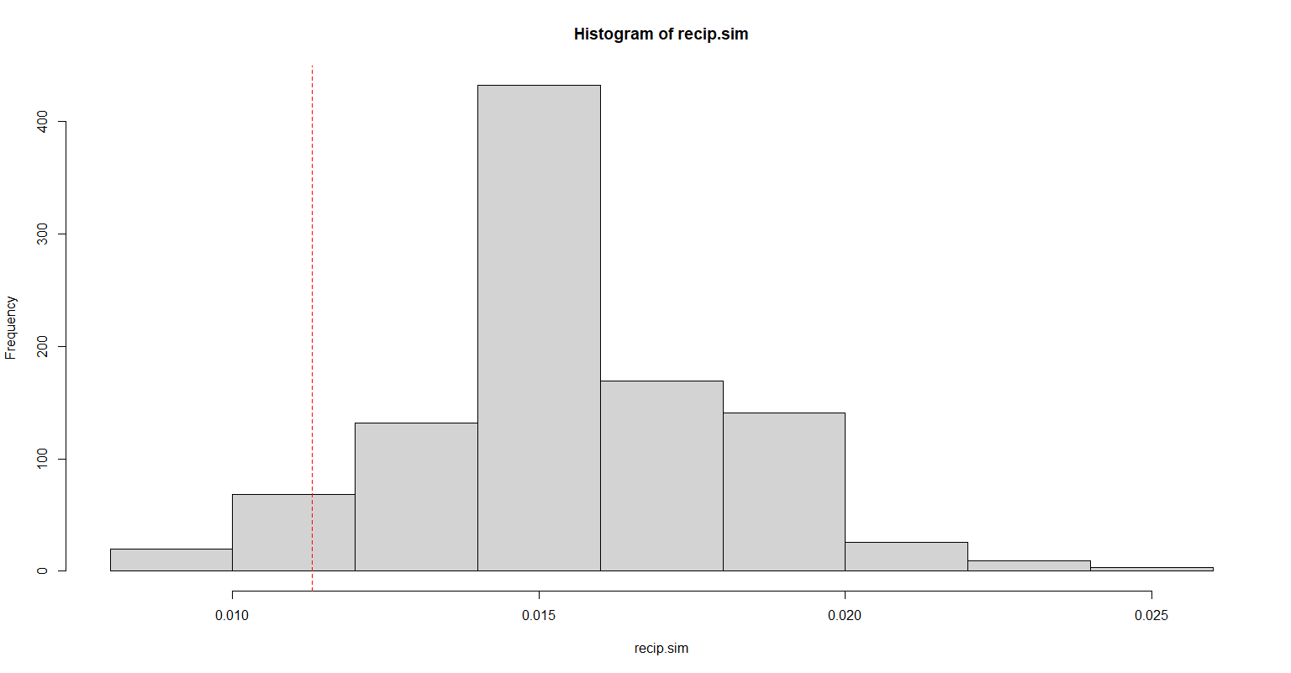
Non-Homogeneous Exponential Random Graph Test-Formal Approach
Reciprocity p-value | 0.088

Slide 30
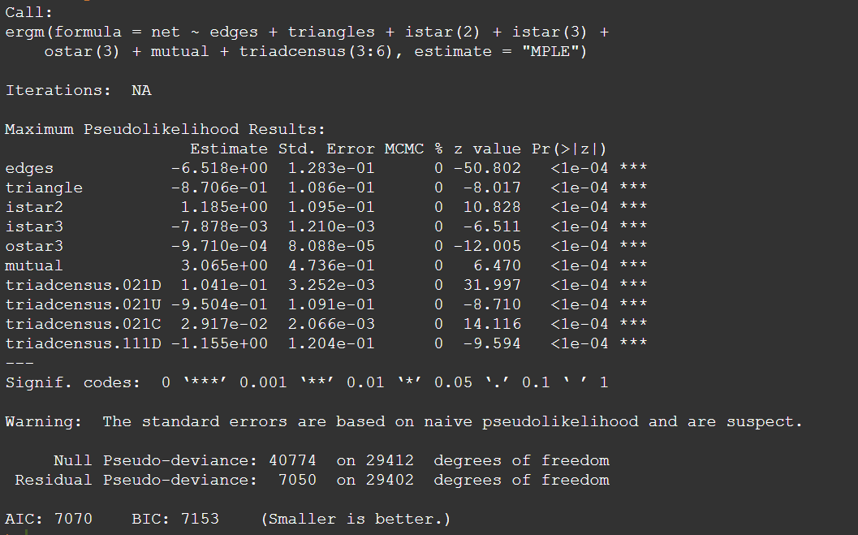
Model Selection
Markov Graph Model with MPLE estimation

Slide 31
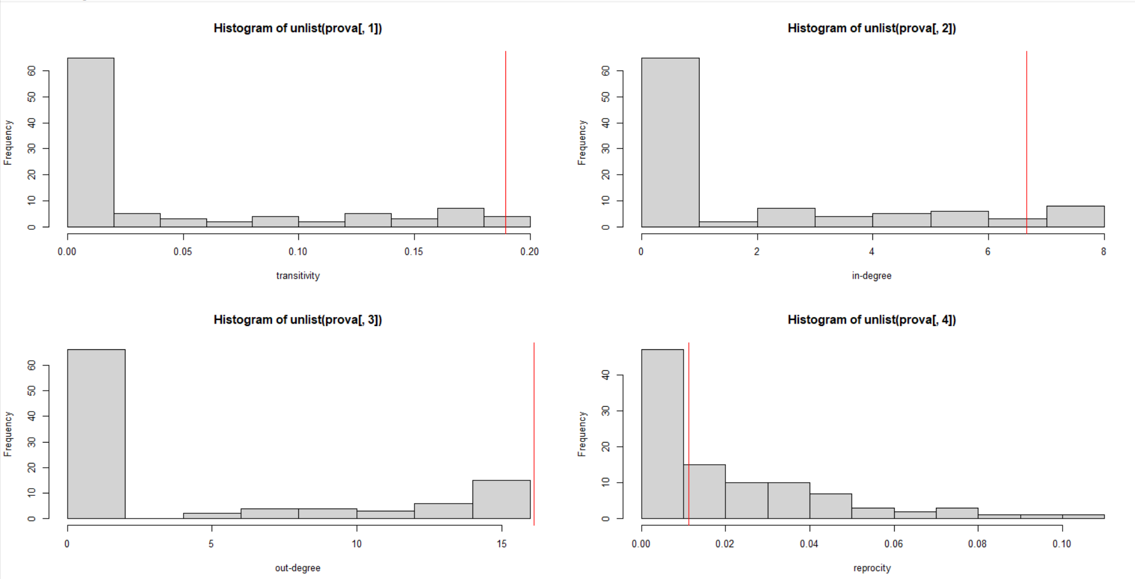
Model Selection
Markov Graph Model with MPLE estimation

Slide 32
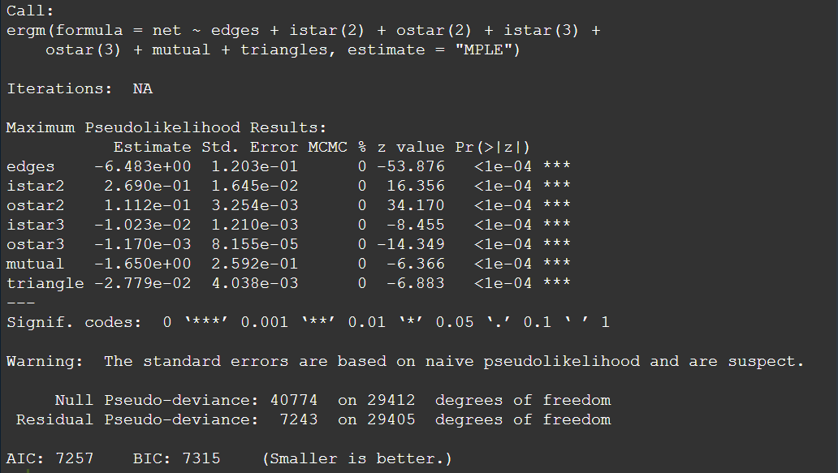
Model Selection 2
Markov Graph Model with MPLE estimation

Slide 33
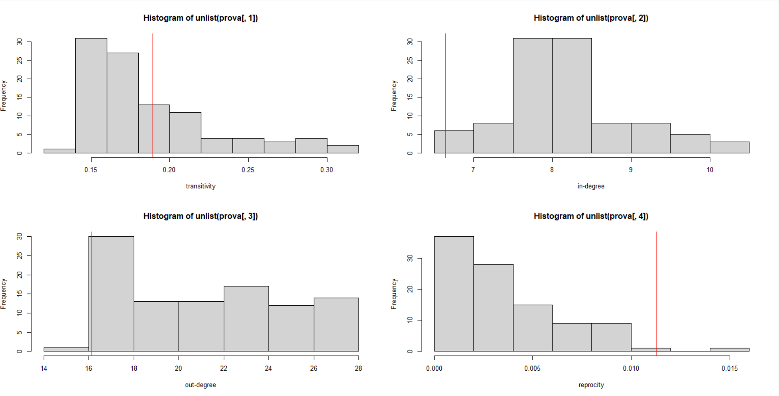
Model Selection 2
Markov Graph Model with MPLE estimation

